Slide 1

PFA HOUSING LOAN PROJECT
BY: TEJENDRA SONI

Slide 2
OBJECTIVE:
We are required to build a model for price of houses with the available independent variables. this model will then be used by the management to understand how exactly the prices vary with the variables. they can accordingly manipulate the strategy of the firm and concentrate on areas that will yield high returns. further, the model will be a good way for the management to understand the pricing dynamics of a new market.
We will now store the data differently for train & test data
Then we will do the preprocessing for both the data
We will build the model using train dataset & then will use that model to predict on test data
Then will show the features that helped us for prediction

Slide 3
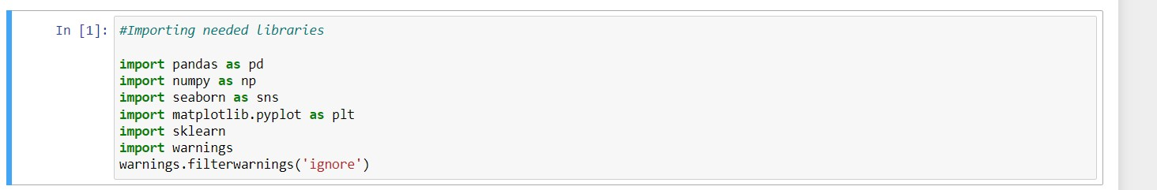
IMPORTING REQUIRED LIBRARIES AND DATABASE:

Slide 4
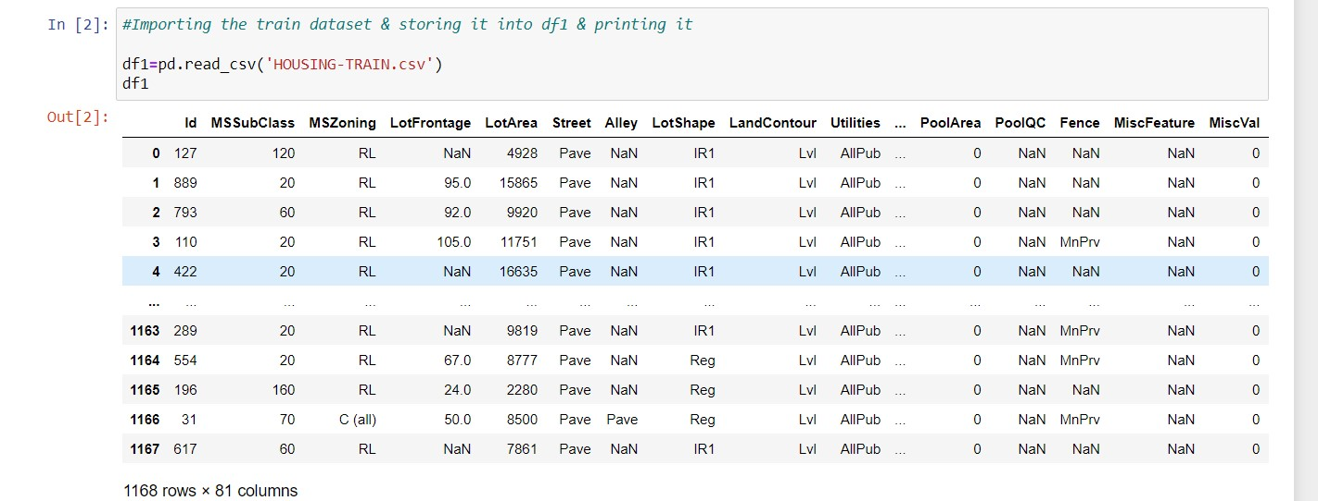
Our dataset has 1168 rows and 81 columns.

Slide 5
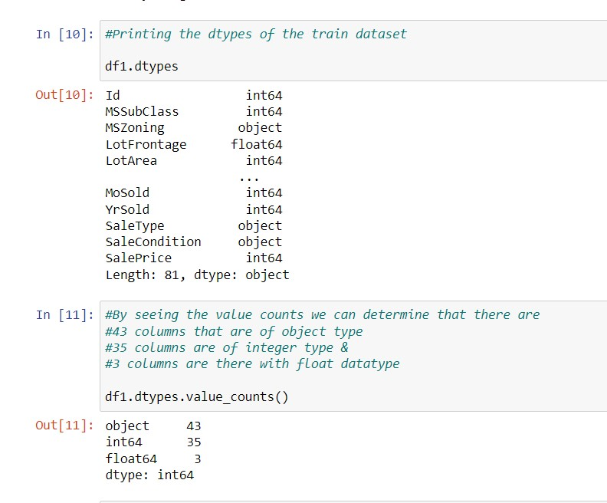
Printing all the data types of the columns that are present in the train dataset
Our dataset is large it is not printing all the columns so we will use value counts functions so that we can determine that how many datatypes are present in our train dataset
Here we can see that 43 columns are of object datatype
35 columns that are of integer datatype
& 3 columns are of float datatype

Slide 6
TREATING THE NULL VALUES

Slide 7
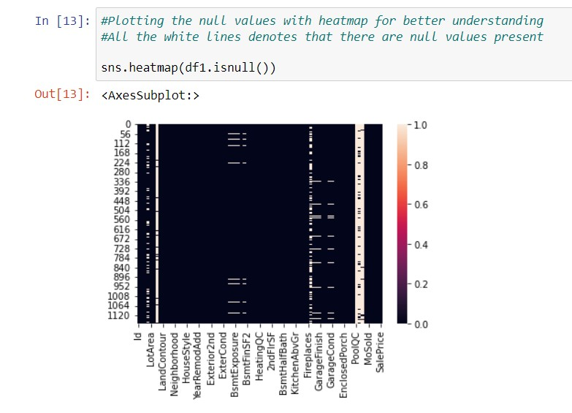
There are some null values present in our dataset showing it with the help of seaborn library & with the heatmap
All the white spots that you can see in the plot are null values shown here

Slide 8
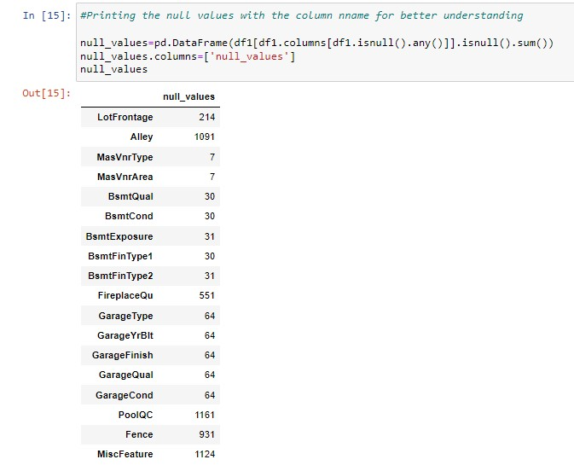
Printing the null values & the column names along with it

Slide 9
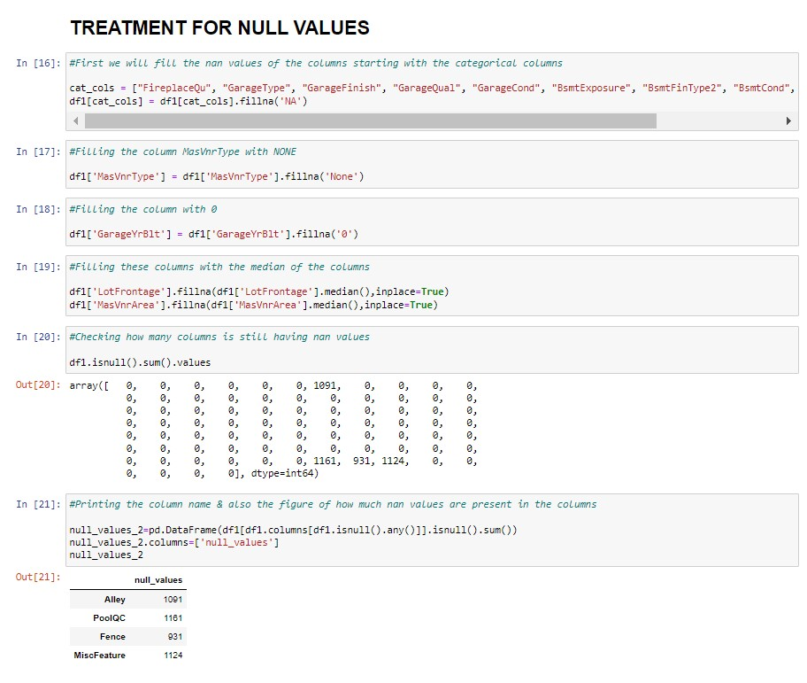
TREATMENT FOR NULL VALUES
Treating the null values according to the columns
Filling the null values accordingly
After removing the null values from the selected columns
After removing the null values we are checking the columns that are still pending
We can see that there are 4 columns remaining

Slide 10
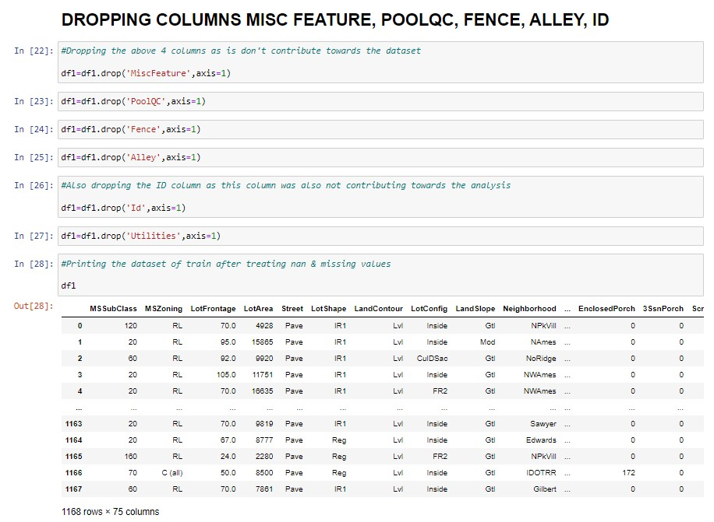
DROPPING THE COLUMNS AS THEY DON’T CONTRIBUTE TOWARDS THE ANALYSIS PART
Dropping these four columns

Slide 11
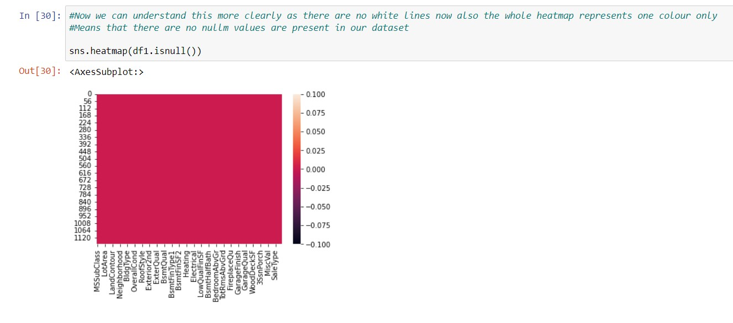
AFTER REMOVING NULL VALUES PRINTING NULL VALUES

Slide 12
VISUALIZATIONS

Slide 13
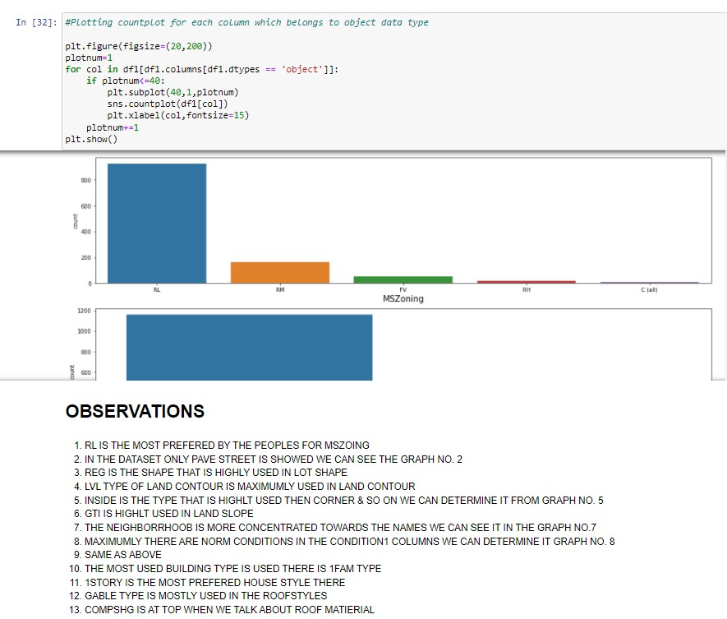
Plotted the count plot for each columns
So that we can determine that in each
Column which variable is mostly used among
All the present once's

Slide 14
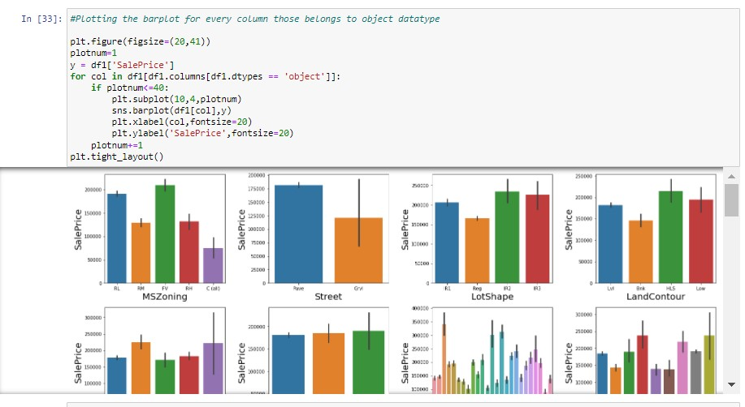
Plotting the bar plot of each column with respect to our target column i.e. sale price

Slide 15
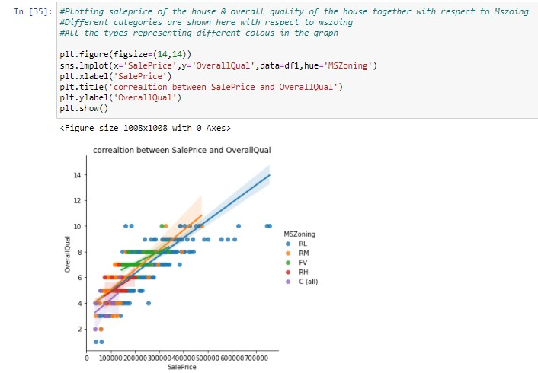
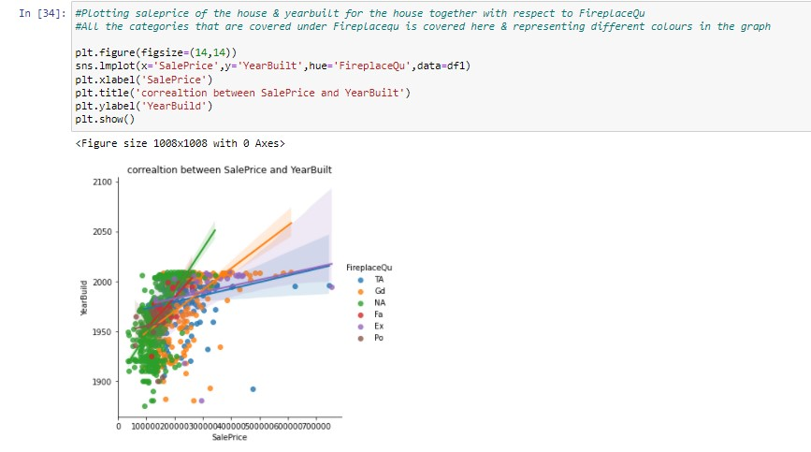
The LM plot stats that SALEPRICE & YEARBUILT are in positive relationship we can here see as the SALEPRICE increases the YEARBUILT of the HOUSES are also increases
We have set hue to fireplace Qu so the plot will work with respect of that column
Here we have set hue=MSZoing means the plot will work with respect to MSZoing

Slide 16
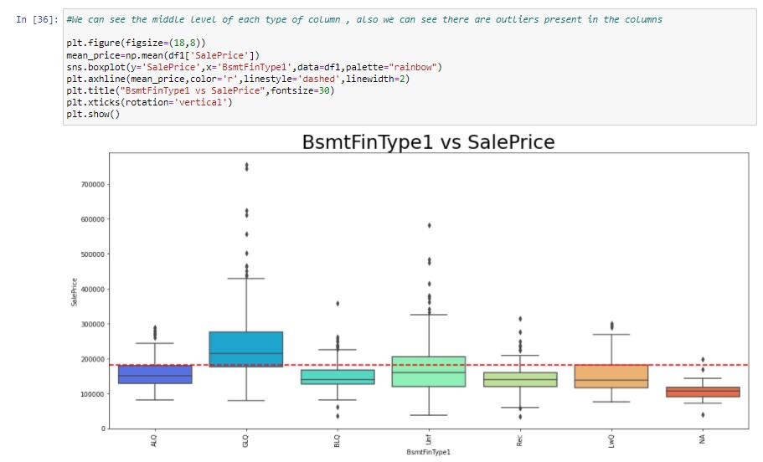
Plotting our Basement type
columns with our target column

Slide 17
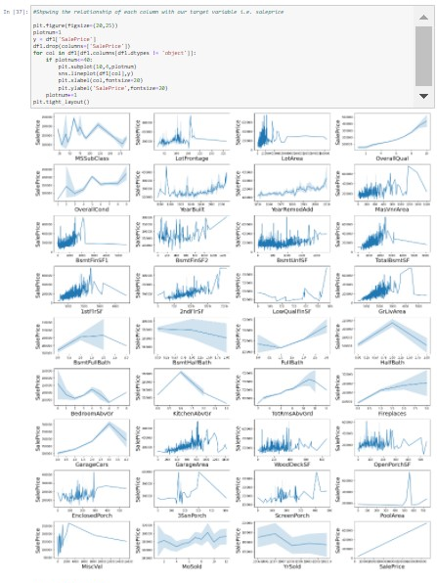
Plotted the line plot of each column with respect to sale price
To determine the positive & negative relationships among the
Columns
OVERALL-QUALITY,OVERALL-CONDITION,FIREPLACES & SALES PRICE ITSELF ALSO
ARE SHOWING HIGHLY POSITIVE RELATIONSHIP WITH THE SALE PRICE
FROM THE ABOVE GRAPH WE CAN SEE THAT THERE IS NOT A SINGLE GRAPH THAT
IS STATING THE NEGATIVE RELATIONSHIP WITH OUR TARGET VARIABLE
THERE ARE SOME COLUMNS WHICH ARE GOING UP & DOWN SO MIGHT BE THEY
ARE CHANGING DUE TO SOME EXTERNALS REASONS BUT THEY ARE NEITHER FULLY POSITIVELY
RELATED NOR NEGATIVELY THEY WILL DIFFER OCCORDING TO THE EXTERNALS REASONS
4. GARAGE-AREA, WOODDECKSF, OPENPORCHSF, ENCLOSED-PORCH & MANY
MORE GRAPH ARE MEDIUM IN THE RANGE

Slide 18
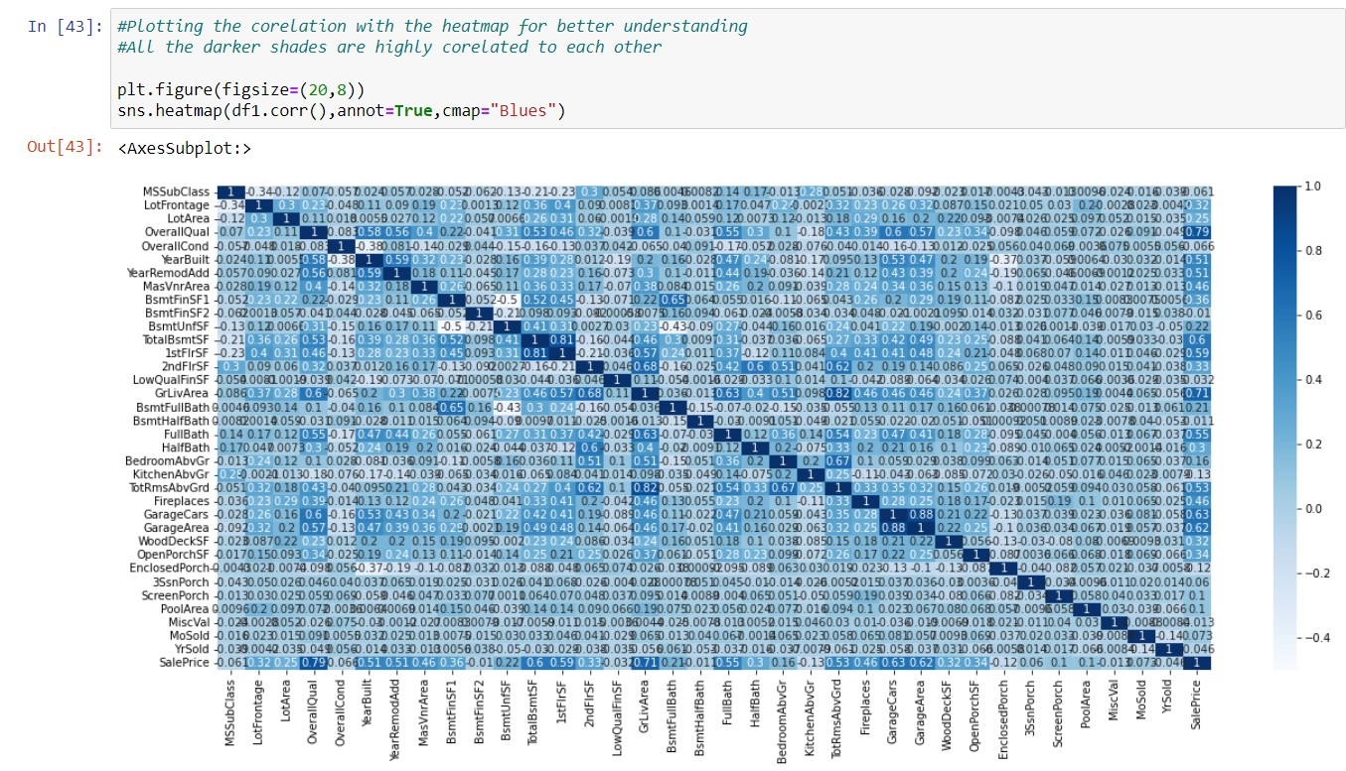
CORRELATION
Plotting the correlation with the heatmap for better understanding
All the darker shades are highly corelated to each other

Slide 19
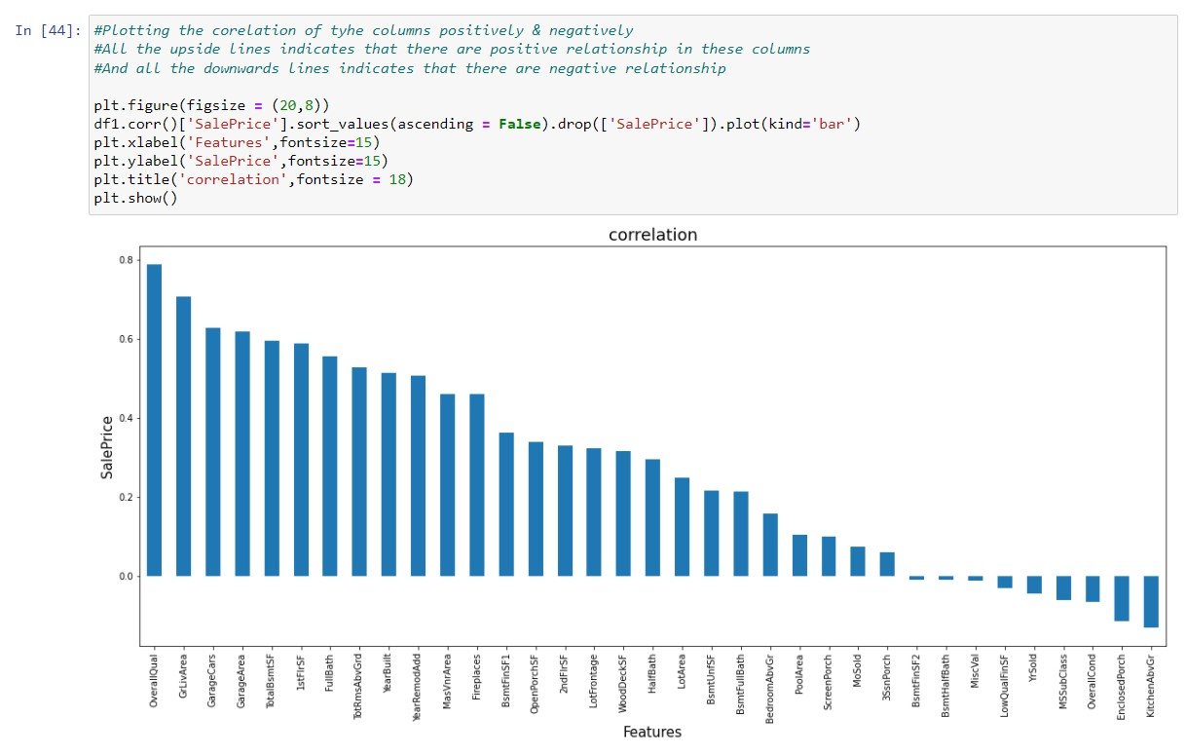
Printing the correlation
Of the columns
We can see that which
Column is positively
Correlated or negatively

Slide 20
OUTLIERS & SKEWNESS REMOVAL

Slide 21
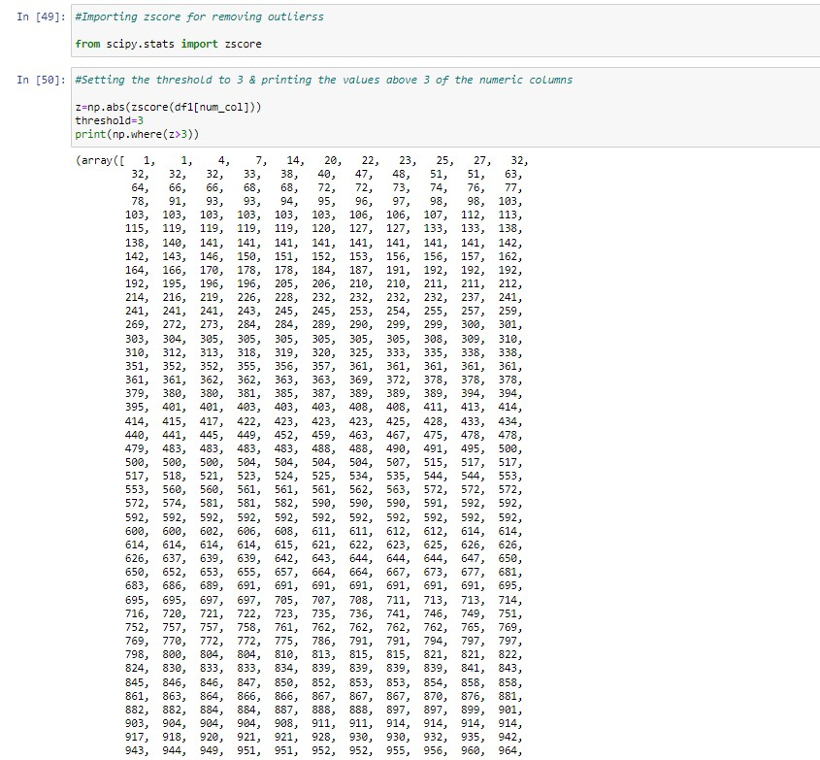
OUTLIERS REMOVAL:
Removing outliers using zscore method

Slide 22
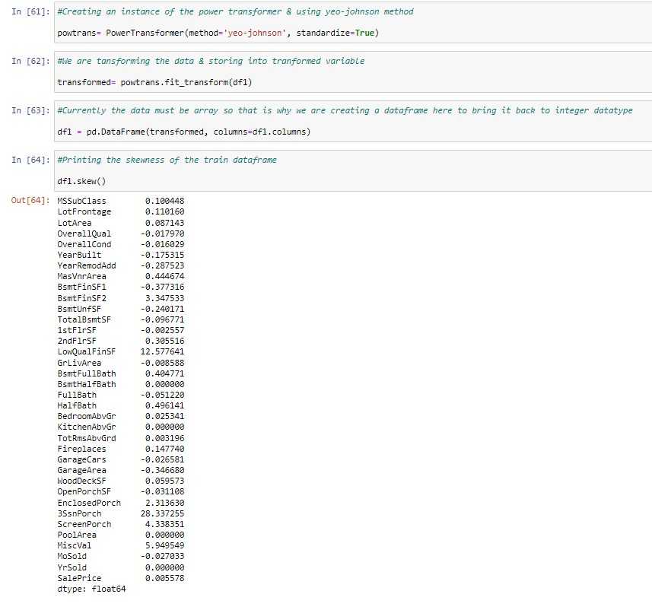
Removing skewness through power transformation
method

Slide 23
SCALING & REMOVING MULTI-COLEANERITY

Slide 24
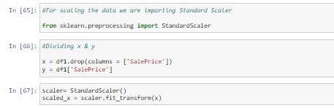
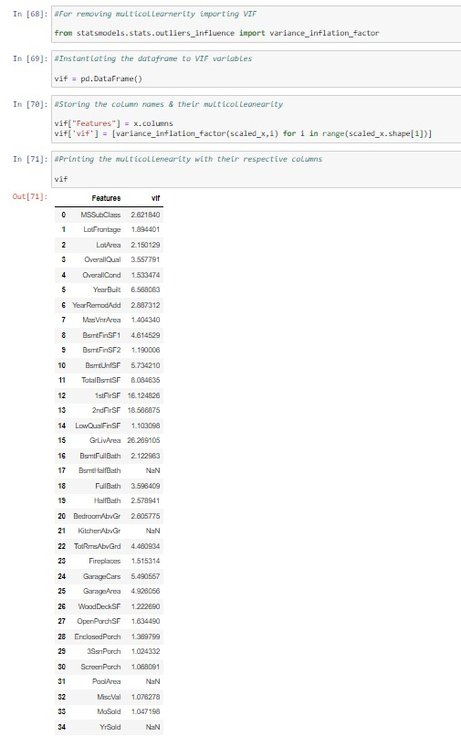
Scaling the data with standard scaler
Using variance inflation factor we are removing the
multicollinearity

Slide 25
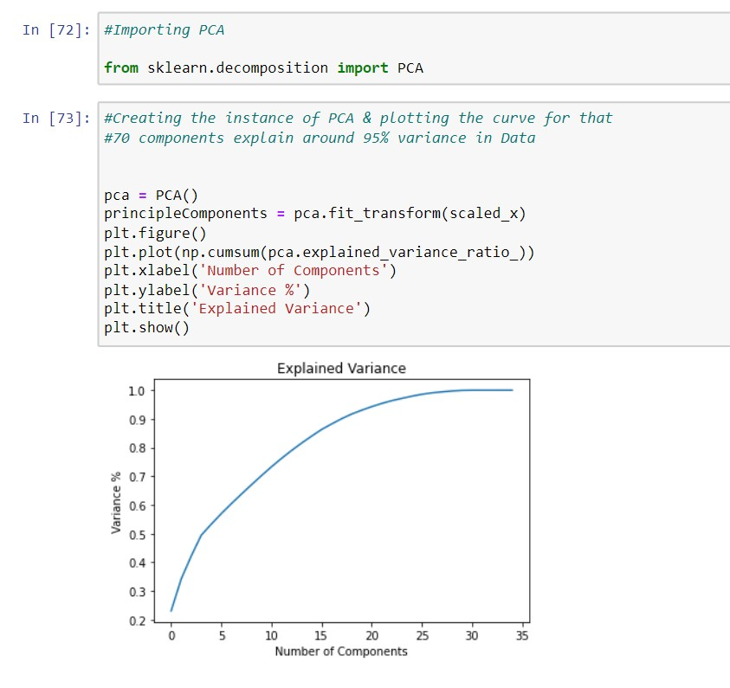
Principle component analysis
Creating the instance of PCA & plotting the curve for that
70 components explain around 95% variance in Data

Slide 26
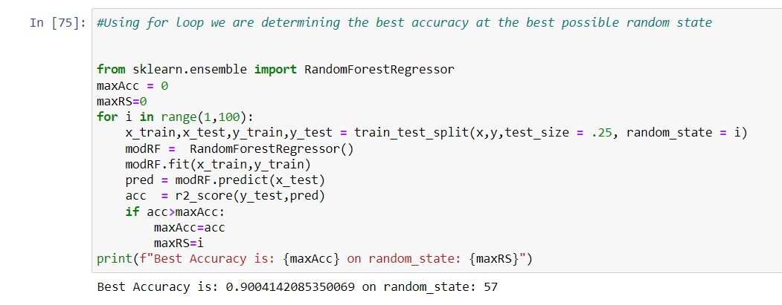
FINDING BEST RANDOM STATE:
Sending the 25% of the data for testing & using for loop determining the best possible accuracy
at the best possible random state

Slide 27
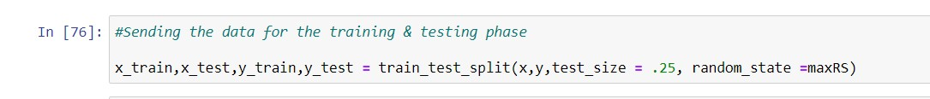
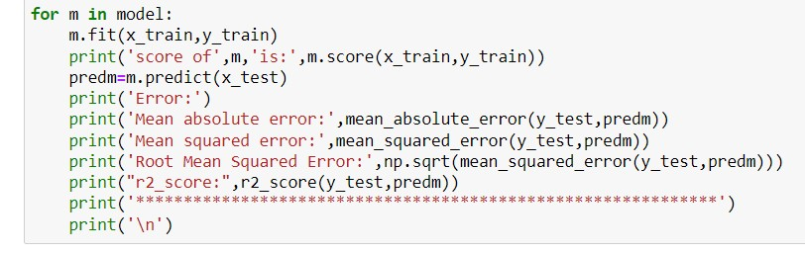
MODEL/S DEVELOPMENT AND EVALUATION:

Slide 28
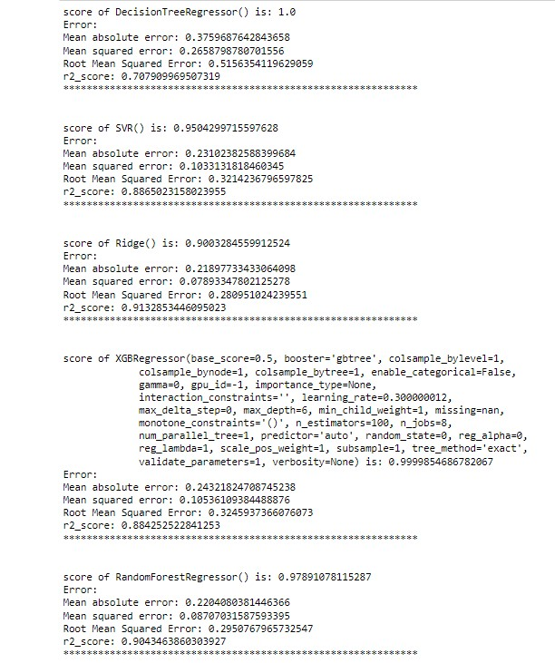
MODEL SELECTION
Here in the table, we can see that Ridge model is giving
Highest R2 score among all the different present models
So, we select the Ridge best for our model
But before proceeding further we will cross validate
Each of the models so that we can finally select which model
Will be the best for our dataset

Slide 29
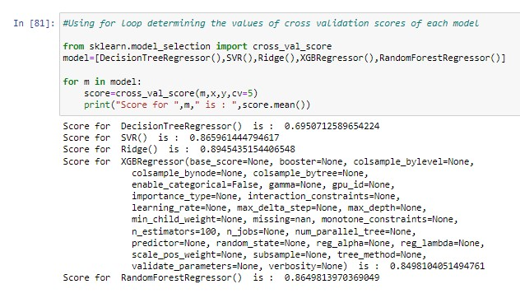
CROSS VALIDATION
After determining the cross-validation scores of the models we will keep the Ridge as our model
Because the Ridge model shows the least difference in all the models

Slide 30
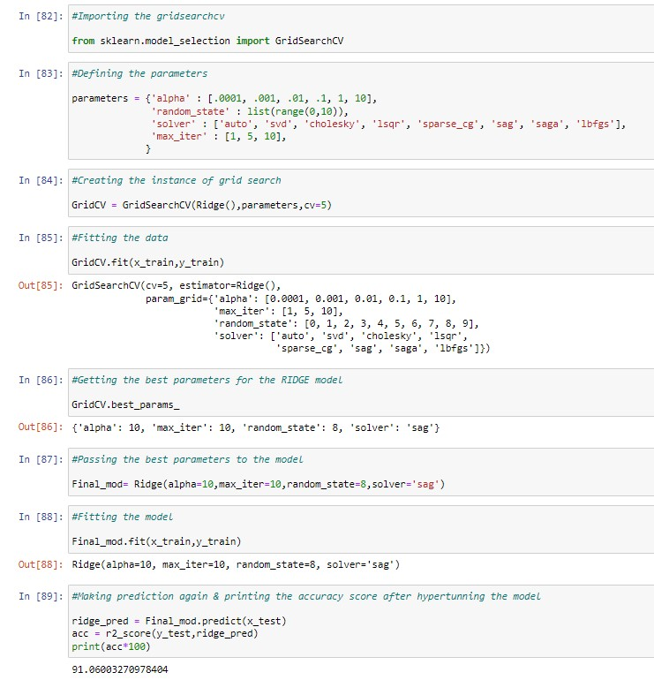
HYPER PARAMETER TUNNING:
Tunning our model to get the best accuracy of the model

Slide 31
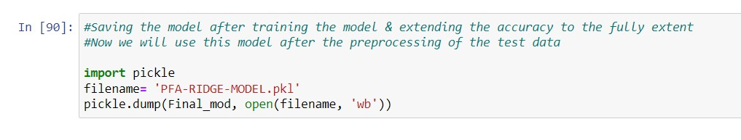
SAVING THE MODEL:
Saving the model with the help of pickle library
Now we will use the saved model after the preprocessing of test data & then we will do the
Analysis on test dataset

Slide 32
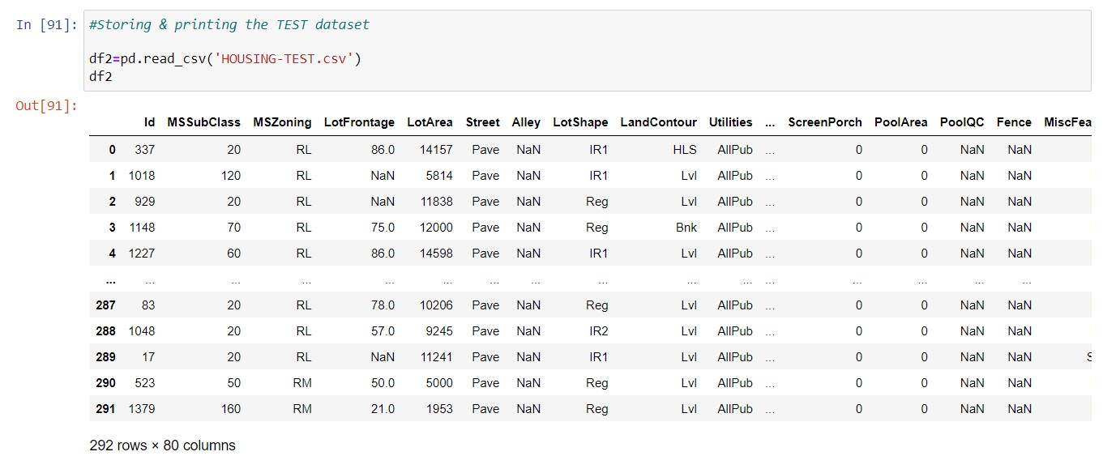
PREPROCESSING ON TEST DATA
It stats that there 292 rows & 80 columns in our test dataset

Slide 33
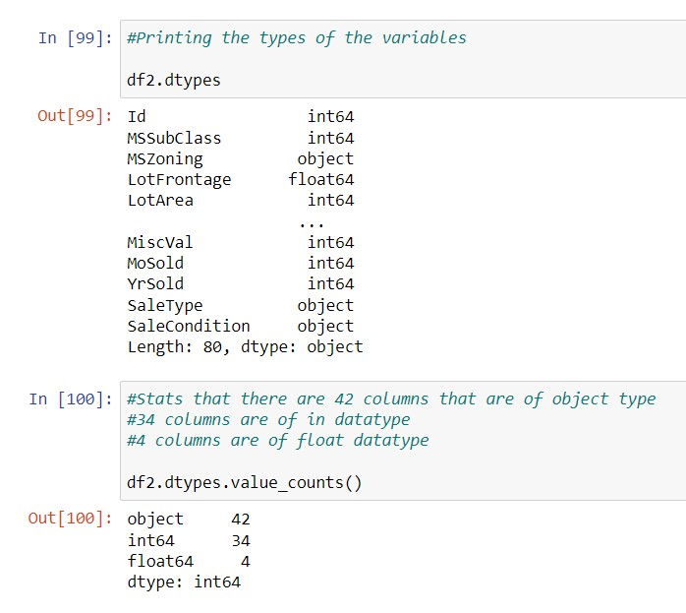
Printing all the datatypes of the columns &
Also, the values counts so that we can
Determine that which column belongs to
The datatypes

Slide 34
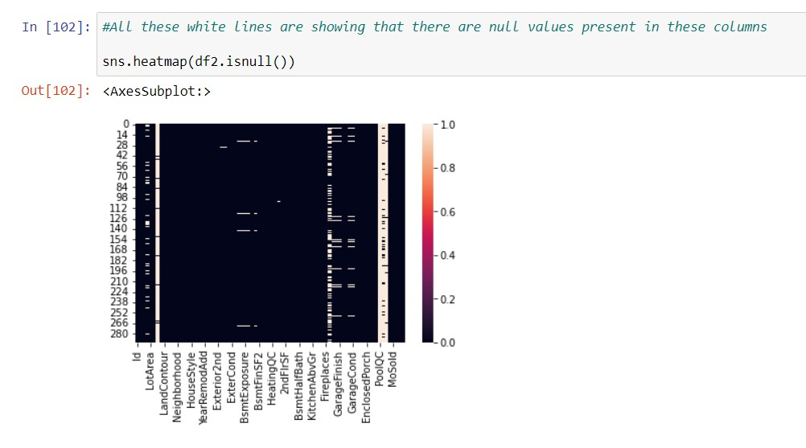
TREATING THE NULL VALUES FOR TEST DATASET

Slide 35
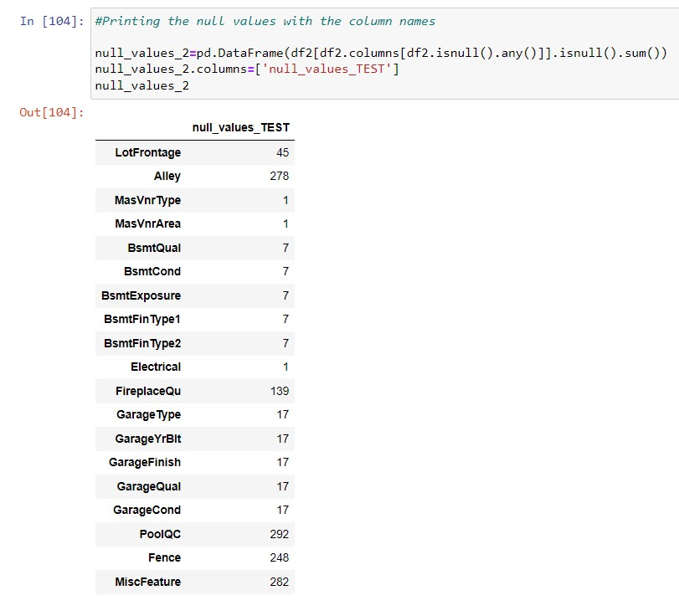
Printing the column names & also printing the
Values which column have the null values

Slide 36
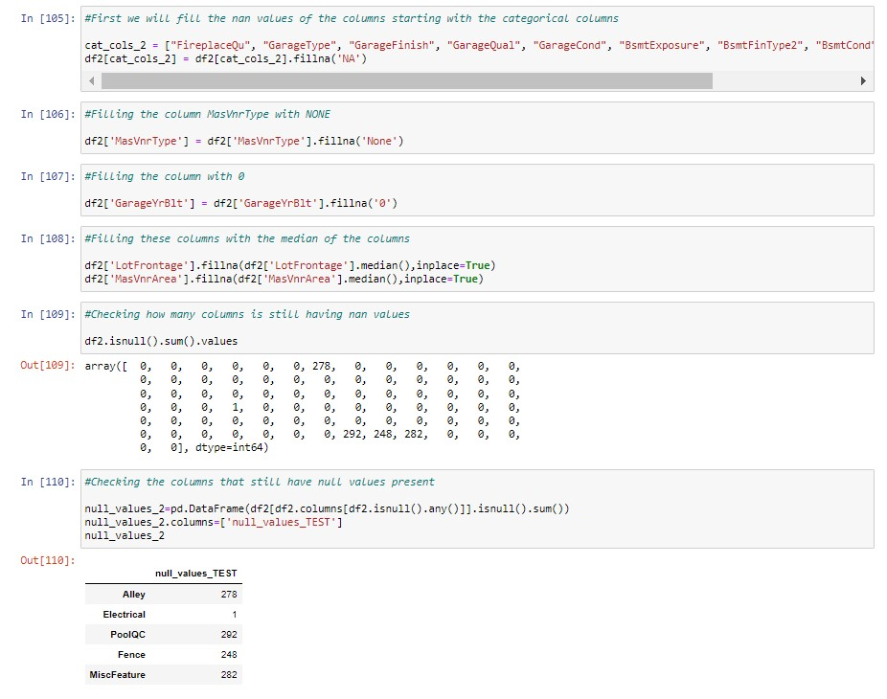
Filling the null values accordingly to the
columns
After filling out the values checking how
many columns still have null values
As we can see there are 5 columns that
have null values

Slide 37
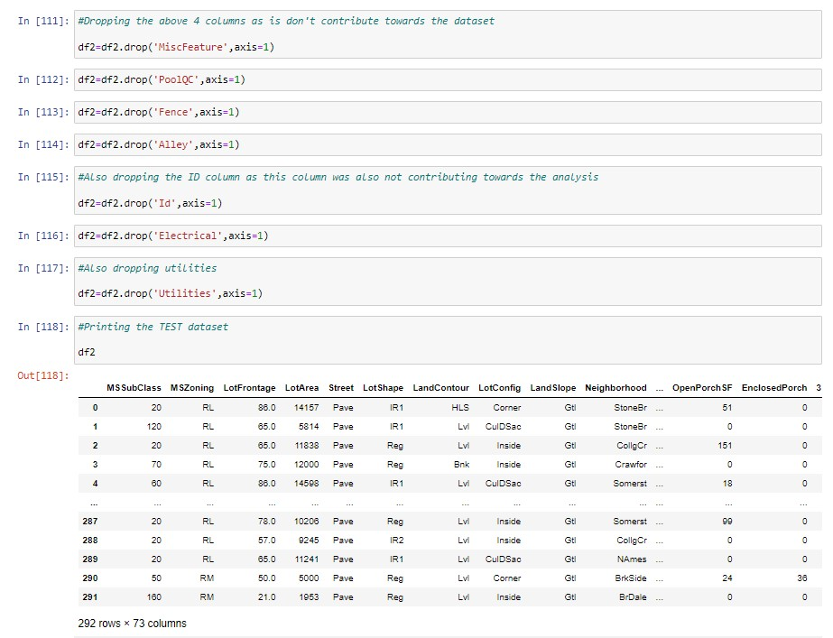
Dropping the 5 columns as they don’t
contribute in the analysis part
Printing the data frame

Slide 38
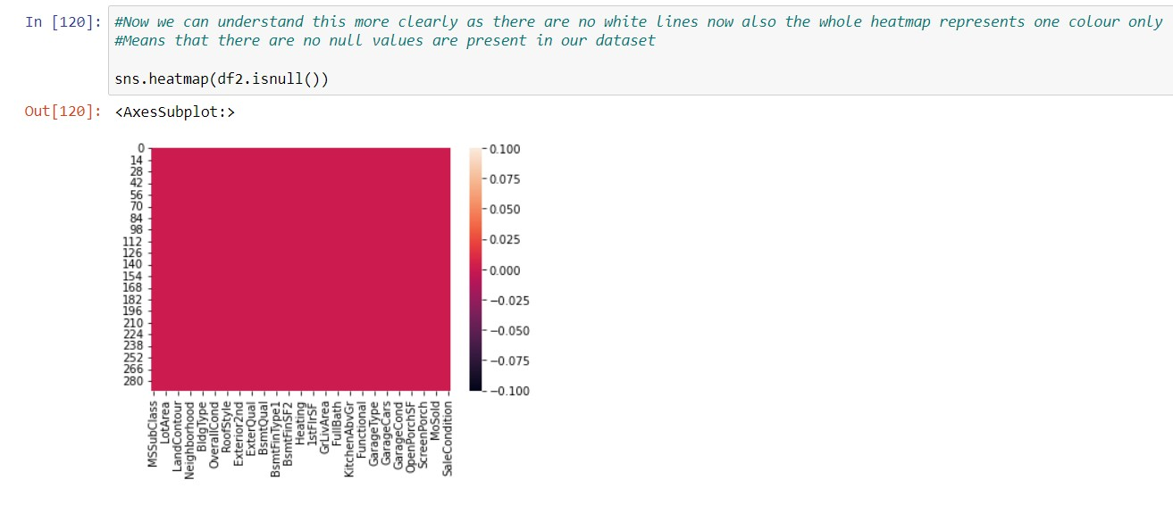
There are no null values now

Slide 39
VISUALIZATIONS FOR TEST DATASET

Slide 40
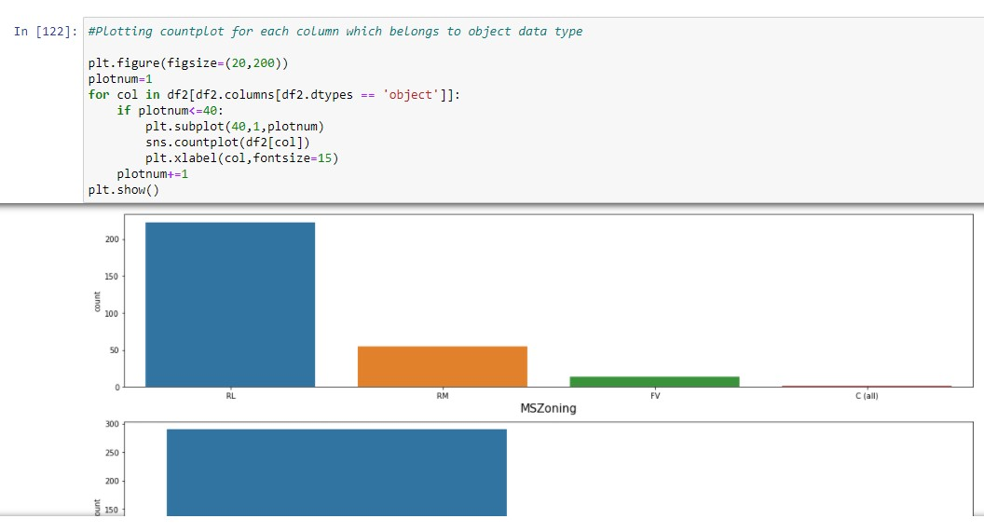
Plotting the count plot
Of each column so that we
Can determine that which
Variables are mostly used
In all the columns

Slide 41
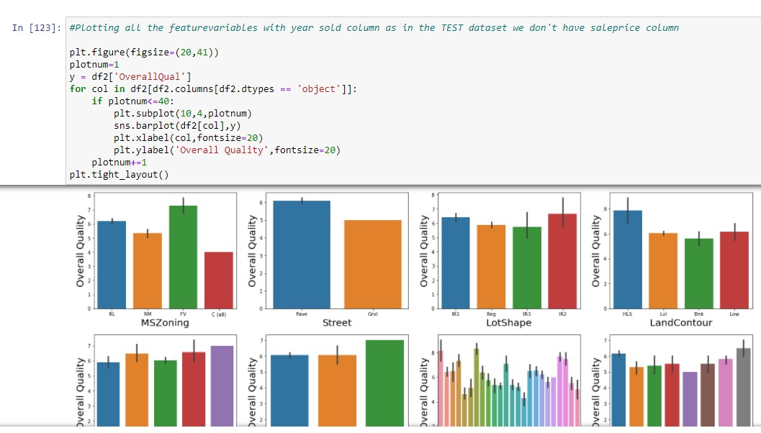
As in the test dataset
We don’t have our target
Variable so we will plot all the
Bar graphs with respect to
Overall quality

Slide 42
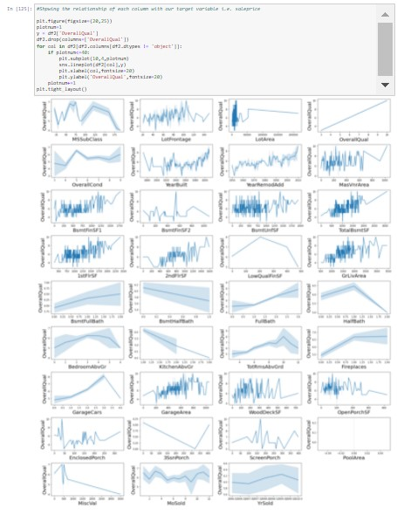
Plotting line plot of each column with respect to overall quality

Slide 43
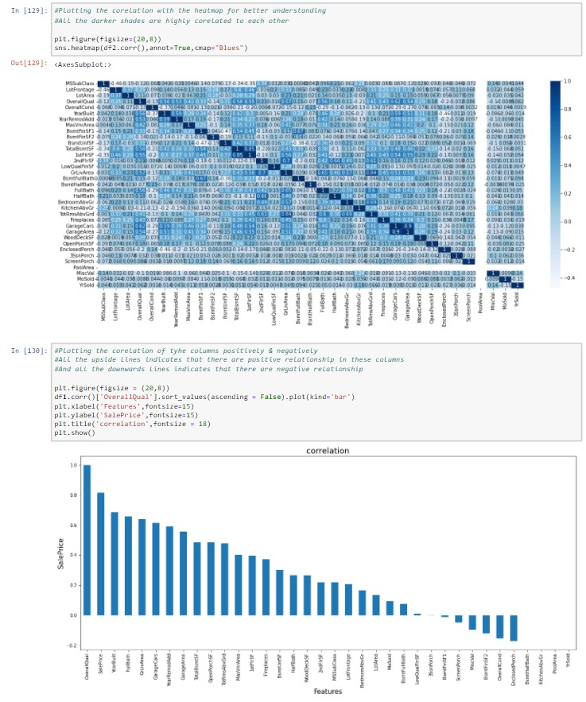
correlation
Plotting the correlations of each column
Also plotting column wise positively & negatively
correlated columns

Slide 44
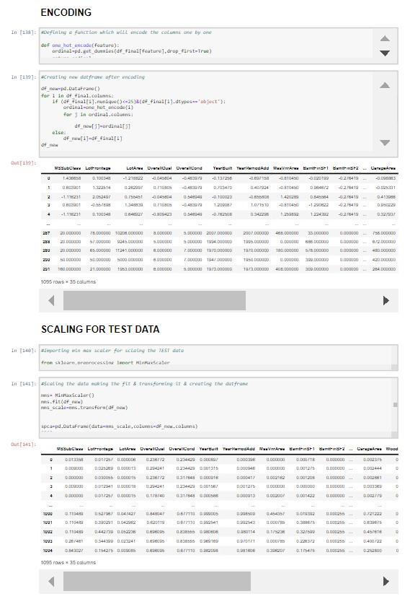
ENCODING & SCALING
Doing encoding & scaling the data

Slide 45
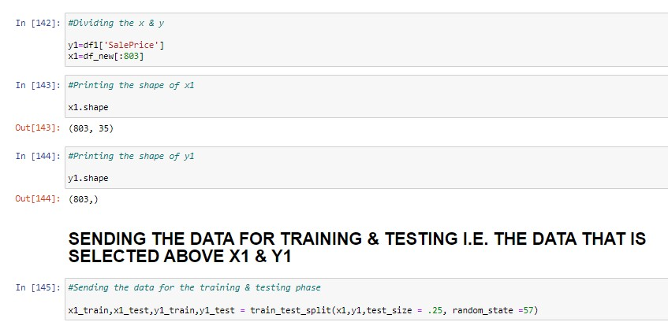
STORING X & Y AGAIN AGAIN SENDING THE DATA FOR TRAINING & TESTING

Slide 46
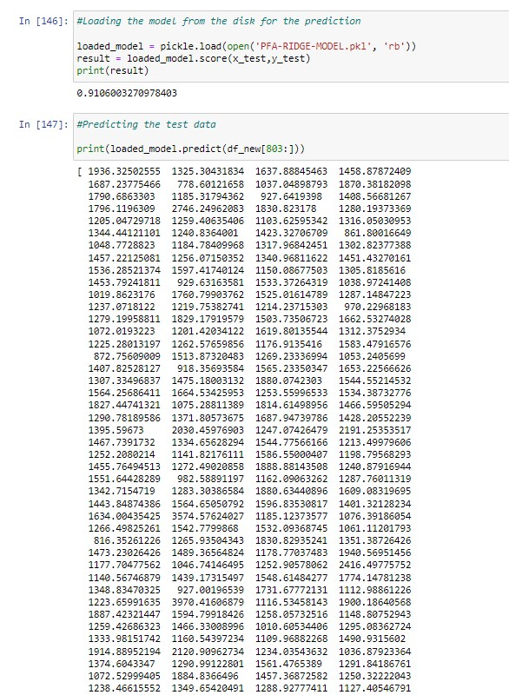
Storing the model back for making analysis on test data
Storing the model back & making
Prediction from it for test dataset

Slide 47
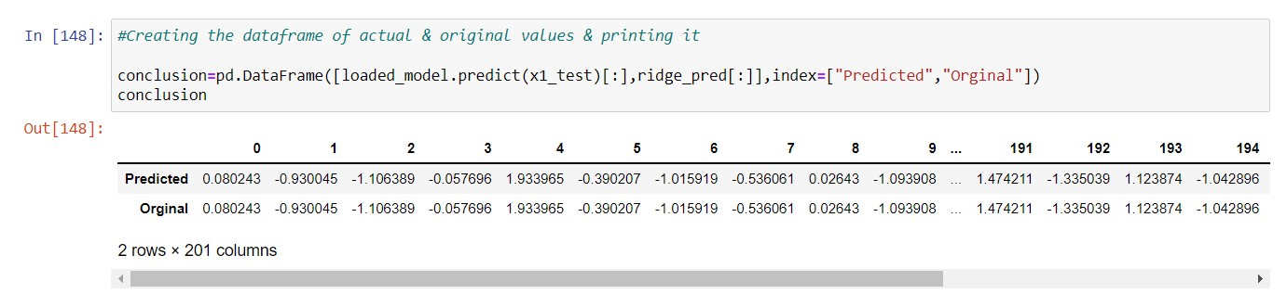
CONCLUSION
Also, making a data frame of predicted answers & measured answers & printing it

Slide 48
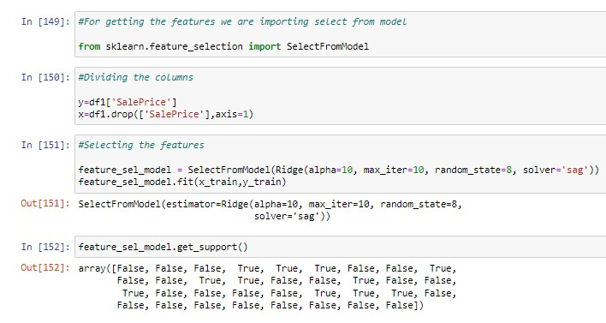
Selecting the features that has positively supported us for our target variable

Slide 49
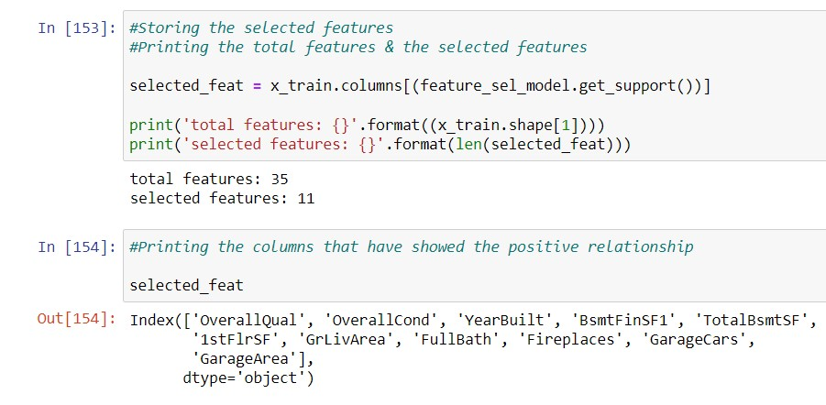
Printing the names of the columns that have helped us

Slide 50
THANK YOU

